Slide 1
CHAPTER 10
REVIEWING PERFORMANCE

Slide 2
Key performance indicators as sources of data to evaluate business performance
Businesses need to regularly evaluate their efficiency and effectiveness in order to improve and remain competitive.
The efficiency and effectiveness of business processes can be measured against a range of data sources and key performance indicators (KPIs).

Slide 3
Key performance indicators as sources of data to evaluate business performance
For a KPI or data source to be useful, it must be:
Relevant
Valid
Reliable
Deliver useful information
Comparative (over time, or to business benchmarks)

Slide 4
Key performance indicators used to evaluate the performance of a business
KPIs can include percentage of market share, net profit, rate of productivity growth, number of sales, rates of staff absenteeism, level of staff turnover, level of wastage, number of customer complaints and number of workplace accidents.
Businesses can use KPIs to assess whether or not business objectives are being met.

Slide 5
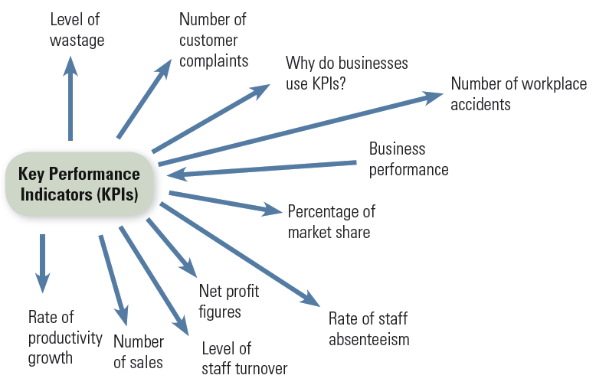
Key performance indicators used to evaluate the performance of a business

